Slide 1
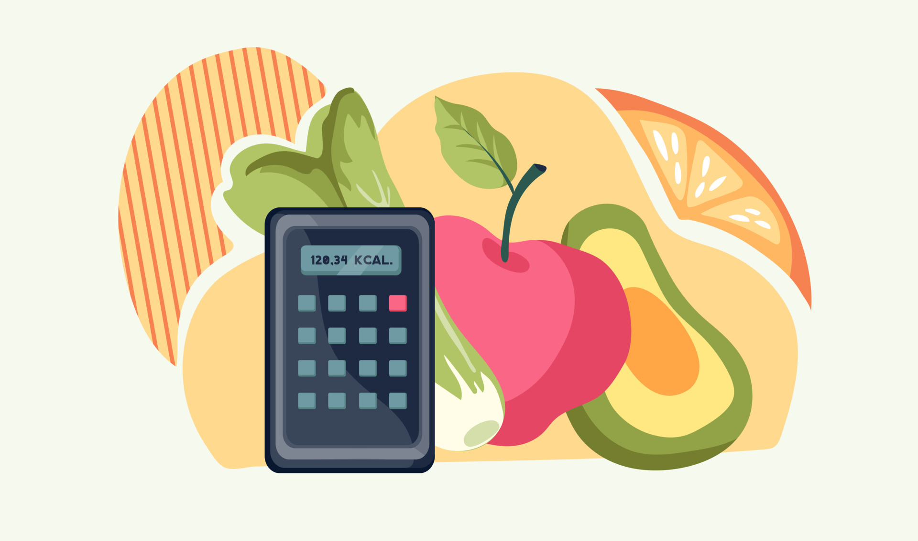
Advanced Food Recognition and Calorie Tracking System
CS584 Machine Learning
PRESENTED BY :
A20598756 - Carlos González-Chamorro A20594446 - Rudra Hirenkumar Patel
A20459115 - Tyler Keating
A20586100 - Thejaswini Mundargi
A20598464 - Gayatri Sanjay Gaikwad
Under Guidance of Prof. Shouvik Roy
Created by : Rudra Hirenkumar Patel

Slide 2
Phase - I
Date : 9 Feb 2025

Slide 3
Contents of Phase - I
Objective of the Project
Background Information
Project Timeline
Background Research
Biggest challenge faced in Phase I
Next steps for Phase II
Challenges and Plans

Slide 4
OBJECTIVE
The objective of the Advanced Food Recognition and Calorie Tracking System is to utilize machine learning to accurately estimate the calorie content of food items from images.
The system aims to automate calorie tracking, reducing manual input and improving accuracy in dietary monitoring.
Created by : Carlos González-Chamorro

Slide 5
BACKGROUND INFORMATION
The problem:
Inaccurate and labor-intensive manual food logging.
Lack of personalized dietary insights based on eating habits.
Why it Matters:
Rising rates of diet-related health issues demand better nutritional monitoring.
Automated systems can reduce costs and improve diet management.
Personalized everyday recommendations can lead to healthier lifestyle.
Technological Background:
Convolutional Neural Networks (CNNs): Used to identify food items from images.
Multi-Layer Perceptrons (MLPs): Estimate calorie content and nutritional values.
Recurrent Neural Networks (RNNs): Analyze eating patterns over time.
Created by : Carlos González-Chamorro

Slide 6
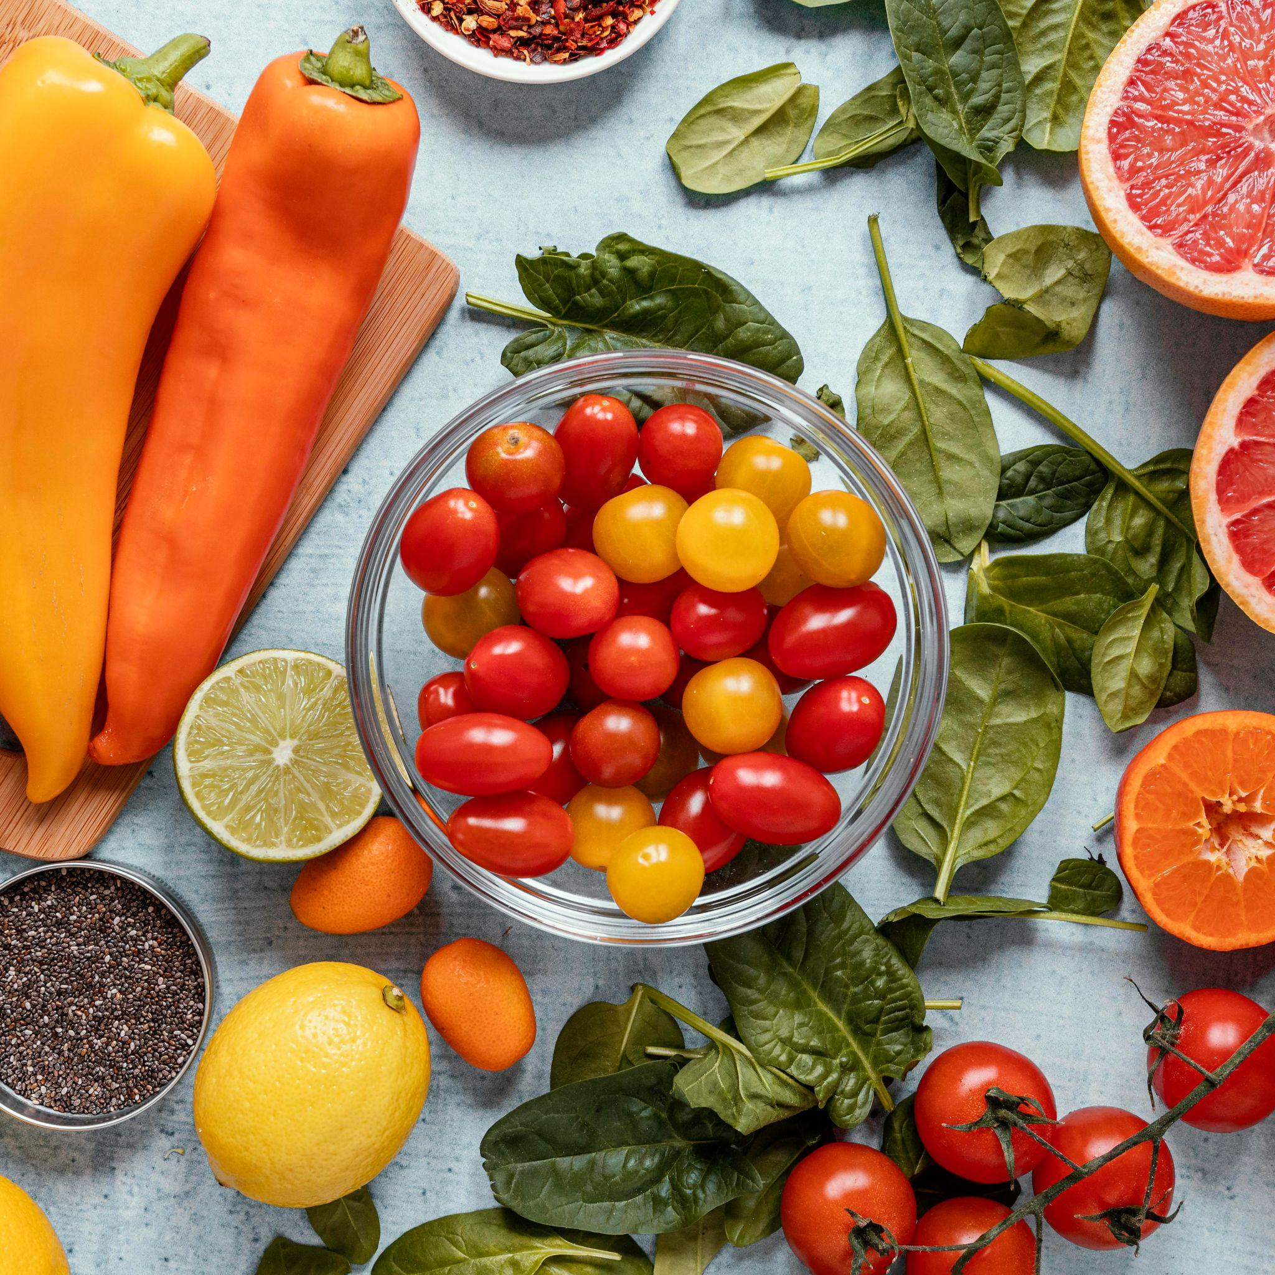
PROJECT TIMELINE
Phase I 📅 02/09/2025
Selecting Project Topic
Define the project scope, research existing methods, and gather relevant datasets for food calorie estimation.
Phase II 📅 03/16/2025
Mid-Semester Project Update
Preprocess the dataset, explore feature engineering, and implement baseline ML models for calorie estimation.
Phase III 📅 04/20/2025
Final Project Update
Optimize models, compare results, and integrate the best-performing approach into a functional prototype.
Final Report Submission 📅 04/02/2025 – 05/02/2025 Document methodology, results, and findings. Submit the final project report.
Created by : Rudra Hirenkumar Patel

Slide 7
DATASET
Food-101 Dataset: This dataset comprises 101 food categories, each containing 750 training and 250 test images, totaling 101,000 images. The training images include some noise, while the test images have been manually cleaned.
UEC-Food 256 Dataset: This dataset contains 256 food categories, each with images annotated with bounding boxes indicating the location of the food item in the photo. It is particularly useful for object detection tasks.
USDA Food Data Central API: This API provides access to a comprehensive database of food and nutrient profiles, including information on over 300,000 foods. It is valuable for obtaining detailed nutritional information to support dietary choices and nutritional analysis.
Created by : Thejaswini Mundargi

Slide 8
DATA PRE-PROCESSING
DL Approach: We will be using the Deep Learning Models such as Convolutional Neural Networks (CNNs), Recurrent Neural Networks (RNNs), and Multilayer Perceptrons (MLPs) in developing an Advanced Food Recognition and Calorie Tracking System.
CNNs are great for image classification in food recognition, RNNs handle sequential data for tasks like analyzing cooking processes, and MLPs integrate features or process structured data. Together, these models enable accurate food recognition and calorie tracking.
Image Augmentation: Apply techniques such as rotation, flipping, and scaling to artificially expand the dataset. Data augmentation helps in improving the model's robustness and generalization capabilities.
Normalization: Scale pixel values to a range of 0 to 1 or standardize them to have a mean of 0 and a standard deviation of 1. Normalization accelerates the convergence of the training process and leads to better performance.
Sequence Formatting: For models that require sequential input, such as Recurrent Neural Networks (RNNs), format the data into sequences. This step is essential for models that process data in a temporal or sequential manner.
Created by : Thejaswini Mundargi

Slide 9
Developing a machine learning model for calorie estimation from food images involves several key steps:
Dataset Collection: To gather a diverse set of food images, each labeled with its corresponding calorie content. Public datasets like Food-101 or custom datasets can be utilized.
Data Preprocessing: To prepare the images for model training by resizing them to a consistent dimension, normalizing pixel values, and applying data augmentation techniques such as rotation and flipping to enhance model robustness.
Model Selection: To choose an appropriate machine learning model, such as Convolutional Neural Networks (CNNs), known for their effectiveness in image classification tasks.
Model Training: To train the selected model on the preprocessed dataset, adjusting hyperparameters to optimize performance.
Model Evaluation: To assess the model's accuracy and generalization capabilities using validation and test datasets.
Calorie Estimation: To implement the trained model to predict calorie content from new food images.
Integration and Deployment: To develop an application or interface that allows users to input food images and receive calorie estimates, facilitating practical use of the model.
Created by : Thejaswini Mundargi

Slide 10
BIGGEST CHALLENGE FACED IN PHASE I
Data Pre-processing Complexity:
Handling diverse data types was challenging.
Ensuring consistency in image formats and proper labeling for CNN training.
Dealing with missing or inconsistent nutritional data in APIs.
How we Overcame it :
Applied advanced preprocessing techniques like image augmentation for CNN robustness.
Automated data cleaning scripts for nutritional datasets.
Collaborated as a team to troubleshoot data inconsistencies and optimize preprocessing pipelines.
Created by : Tyler Keating

Slide 11
NEXT STEP FOR PHASE II
MODEL DEVELOPMENT
Train the CNN model using Food-101 and UEC-Food 256 datasets.
Build the MLP model for calorie estimation using USDA data.
Develop the RNN model to analyze user meal patterns.
SYSTEM INTEGRATION
Connect all models into a unified system for seamless data flow.
Start initial testing to identify integration issues.
PROTOTYPE DEVELOPMENT
Create a basic user interface to display food recognition results, calorie estimations and behaviour insights
Created by : Gayatri Sanjay Gaikwad

Slide 12
CHALLENGES AND PLANS
AREA | CHALLENGES | MITIGATION
Model Overfitting | Risk of CNN overfitting on food images due to limited data variety. | Apply regularization techniques, dropout layers, and data augmentation.
Portion Size Estimation | Difficulty in accurately estimating portion sizes from images. | Explore AR-based estimation methods in future phases.
Data Privacy Concerns | Handling sensitive user data securely. | Implement data encryption and secure API communication.
Integration Complexity | Combining outputs from CNN, MLP, and RNN models may lead to compatibility issues. | Use modular architecture for flexible model integration.
Created by : Gayatri Sanjay Gaikwad

Slide 13
CONCLUSION
In summary, the project on calorie estimation using machine learning and neural networks aims to develop an accurate and efficient system for predicting the calorie content of food items based on images. By leveraging advanced machine learning techniques, such as Convolutional Neural Networks (CNNs), RNN and MLP the project seeks to enhance dietary assessments and support healthier eating habits. The successful implementation of this system has the potential to revolutionize personalized nutrition and provide users with reliable nutritional information at their fingertips.
Created by : Thejaswini Mundargi

Slide 14
Phase - ll
Date : 16 Mar 2025

Slide 15
Phase II :
STEPS :
SETTING UP ENVIRONMENT
Google Colab
Installing libraries
DATASET COLLECTION AND PREPROCESSING
Downloading the food dataset
Preprocessing images for CNN
MODEL DEVELOPMENT
Building the CNN Model
Building the MLP Model
Building the RNN model

Slide 16
Environment Setup and Libraries Installation
We have used Google Colab: A cloud-based platform, Helps in fast-prototying with GPU support.
1. Setup Steps:
Create a Colab notebook.
Enable GPU/TPU: Runtime → Change runtime type → Select GPU.
2. Installing core Libraries using:
!pip install --upgrade numpy seaborn opencv-python matplotlib scikit-learn tensorflow keras pandas pillow streamlit virtualenv
NumPy, Pandas, Matplotlib, Seaborn → Data handling & visualization
OpenCV, Pillow → Image processing
TensorFlow, Keras, Scikit-learn → Machine learning models
Streamlit → Web-based UI
Virtualenv → Environment management
3. Verify Setup: Check TensorFlow version and GPU availability
print(f"TensorFlow Version: {tf.__version__}")
print("GPU Available:", tf.config.list_physical_devices('GPU'))
Created by : Thejaswini Mundargi

Slide 17
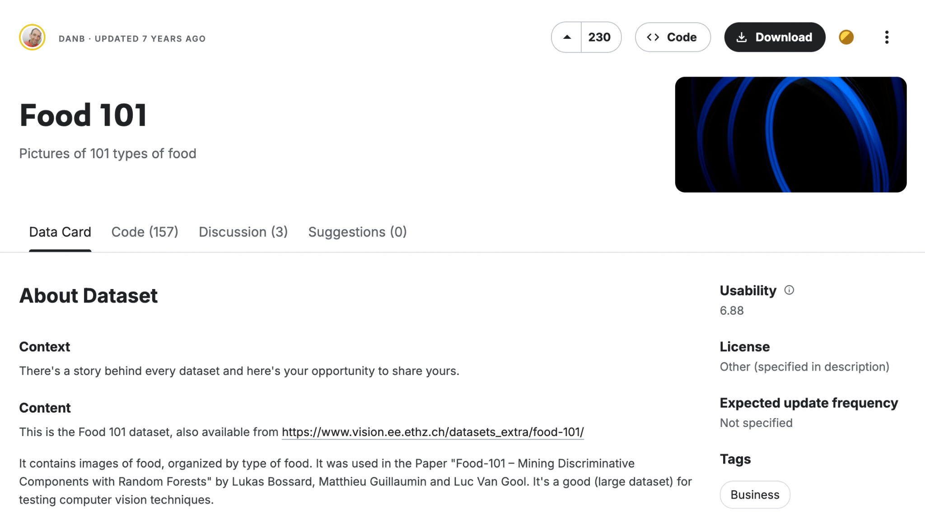
Finding and Downloading Dataset
Finding and Downloading the Dataset:
We selected the Food-101 dataset from Kaggle, which contains 101 food categories with 1,000 images each. To download it:
we visited the Food-101 Kaggle page
Clicked the download button to get the .zip file
Created by : Rudra Hirenkumar Patel

Slide 18
Collecting Dataset and Mounting it
Step 1: Uploading the Dataset to Google Drive
I first downloaded Food 101 from Kaggle. After that, I went to my Google Drive and:
Created a new folder called “Food”.
Uploaded the dataset files into that folder.
Step 2: Mounting Google Drive in Colab
Next, I opened Google Colab and ran the following code to mount my Drive:
from google.colab import drive
drive.mount('/content/drive')
A pop-up appeared asking me to sign in, and I followed the instructions to authenticate my
account.
Step 3: Accessing the Dataset in Colab
Once the Drive was mounted, I accessed my dataset like this: data_dir = '/content/drive/MyDrive/Food'
Created by : Rudra Hirenkumar Patel

Slide 19
Building the CNN model
Preprocessing
Image Specs: Resize to 140×140 RGB images; Batch size of 32.
Data Augmentation:
Rescaling (1./255).
Random rotations (up to 20°), zoom (0.15), width/height shifts (0.2), shear (0.15).
Horizontal flips with nearest fill mode.
Split: 80% training / 20% validation via ImageDataGenerator
Created by : Carlos González-Chamorro

Slide 20
Building the CNN model
Model Architecture
Convolutional Layers:
Block 1: Conv2D with 16 filters (3×3, ReLU) + MaxPooling.
Block 2: Conv2D with 32 filters (3×3, ReLU) + MaxPooling.
Block 3: Conv2D with 64 filters (3×3, ReLU) + MaxPooling.
Classification Head:
Flatten layer.
Dense layer with 64 neurons (ReLU) followed by Dropout (50%).
Final Dense layer with 102 neurons (Softmax) for multi-class prediction.
Compilation: Optimizer: Adam, Loss: Categorical Crossentropy, Metric: Accuracy.
Created by : Carlos González-Chamorro

Slide 21
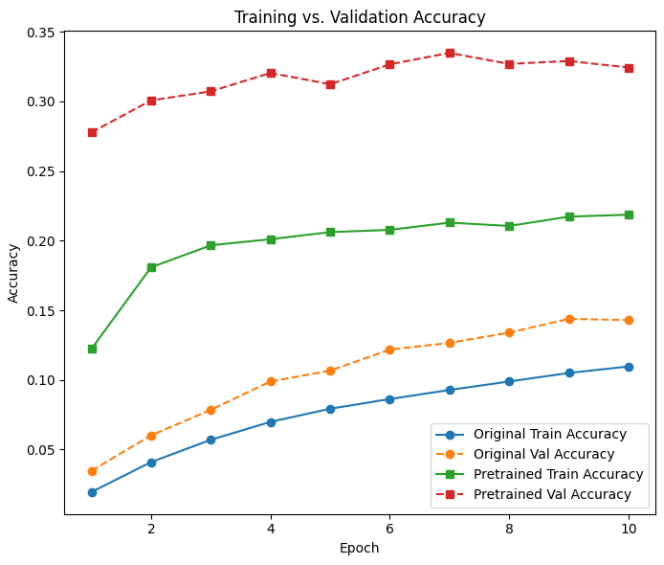
Improving the CNN model
Pretrained MobileNetV2 as Base:
Leverages ImageNet-trained weights.
Uses include_top=False to remove the original classification head.
Freezing the Base Model:
The pretrained base is frozen to retain learned features.
Reduces training time and prevents overfitting during initial training.
Created by : Carlos González-Chamorro

Slide 22
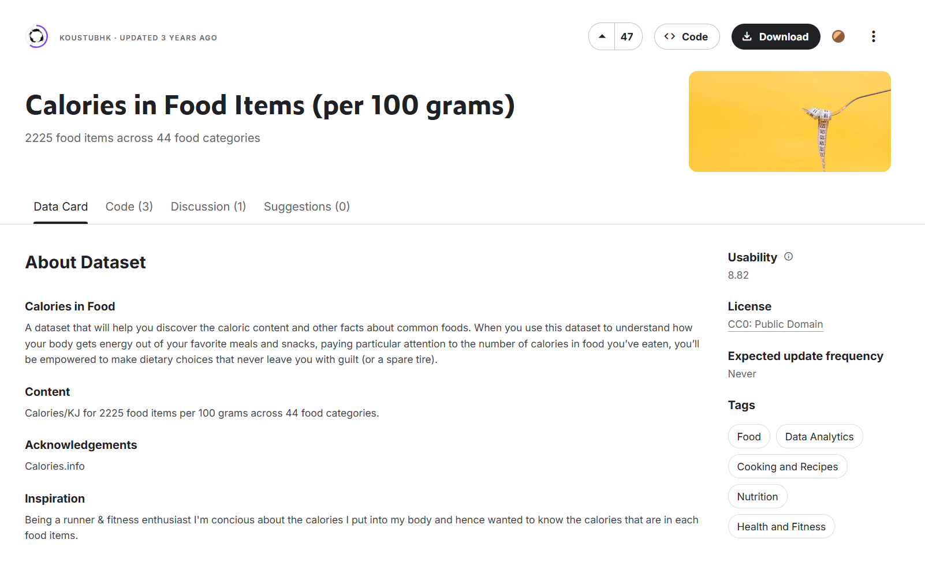
MLP MODEL for calories estimation
Step 1 : DATA OVERVIEW :
.
Dataset: "Calories in Food Items per 100g"
Features: Food labels (encoded) and portion size (randomly generated between 50g-500g).
Target: Calorie content (cleaned and preprocessed).
Step 2 : DATA PREPROCESSING AND MODEL OVERVIEW :
Preprocessing:
Encoding food items to numerical labels.
Handling missing values and cleaning calorie data.
Standardizing input features (food label and portion size).
Model:
Architecture: Dense layers with ReLU activation, Dropout for regularization.
Loss: Mean Squared Error (MSE), Metrics: Mean Absolute Error (MAE).
Early Stopping: To avoid overfitting.
Created by : Gayatri Sanjay Gaikwad

Slide 23
MLP MODEL for calories estimation
Step 3. MODEL ARCHITECTURE - MLP
Input Layer:
Two features: encoded food labels and portion size.
Input shape is (2,), as we have two features.
Hidden Layer:
Layer 1: 64 neurons, ReLU activation.
Layer 2: 32 neurons, ReLU activation.
Layer 3: 16 neurons, ReLU activation.
Dropout Layer:
A 30% dropout rate to reduce overfitting during training.
Output Layer:
One neuron with a linear activation function to predict the calorie value (regression).
Activation Functions:
ReLU used for hidden layers and linear for output layer (regression task).
Created by : Gayatri Sanjay Gaikwad

Slide 24
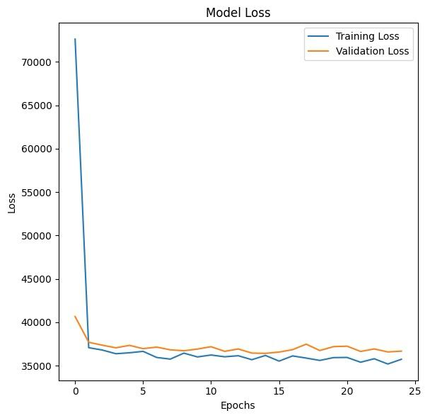
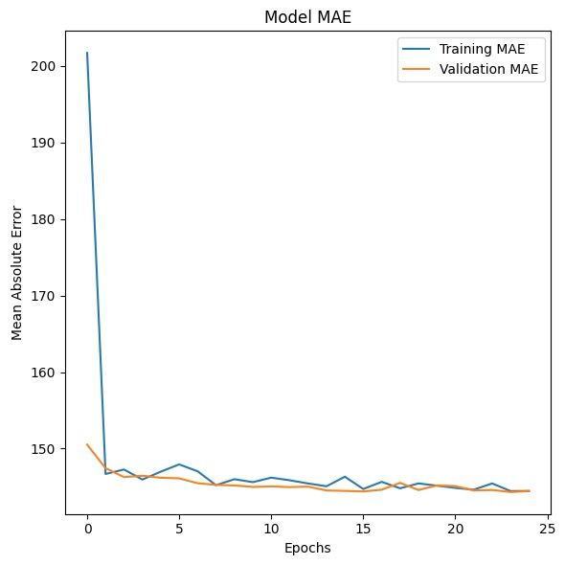
MLP MODEL for calories estimation
Step 4. MODEL COMPILATION AND TRAINING
Training:
Epochs: 50 with batch size of 8.
Validation: 80% training and 20% validation split.
Early Stopping: Monitors validation loss.
Evaluation:
R²: 0.1 (shows average model fit)
RMSE: 190.81.
LOSS AND MAE PLOTS :
Show the progression of training and validation loss across epochs.
Plots help us observe whether the model is overfitting or underfitting.
Training Loss: Decreases with each epoch
Validation Loss: Helps assess how well the model generalizes to unseen data.
Created by : Gayatri Sanjay Gaikwad

Slide 25
MLP MODEL for calories estimation
EXAMPLE PREDICTION :
Take the example of a "Pizza" with a portion size of 150g.
Food Name: "Pizza" → Encoded as a label.
Portion Size: 150g.
Prediction Process:
Use the trained model to predict calorie content for this specific portion size.
Predicted Calories for 150g of Pizza : 239.01 KJ
Created by : Gayatri Sanjay Gaikwad

Slide 26
RNN Model for predicting future trends
Input:
The RNN model takes a sequential series of data that represents the past daily calorie intakes for a user
In an application, it can track the sum of all pictures taken that day
Currently using synthetic data
Output:
The model outputs the user’s predicted daily calorie intake for the next week
Synthetic Data Specifications:
Randomly generated base calories between 1500 and 2500 calories per day
Variation of up to 300 calories per day
Limited to the range of 1200-3500 calories per day
Created by : Tyler Keating

Slide 27
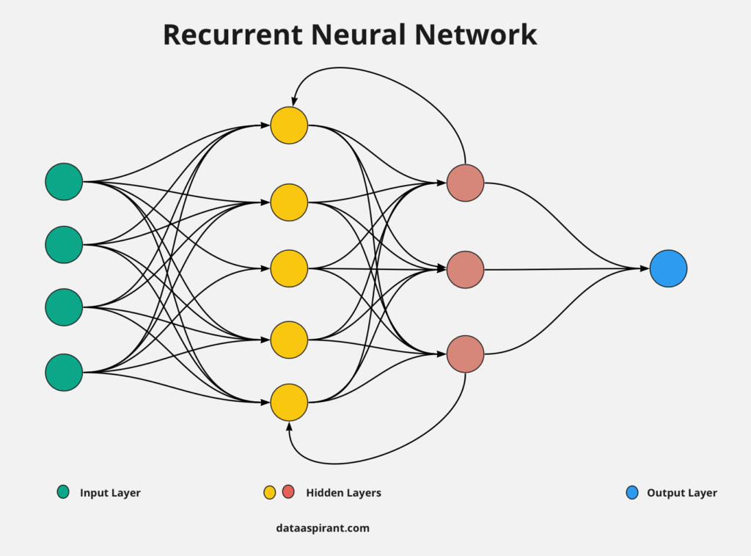
RNN Model for predicting future trends
Model Architecture:
Input Layer: a sequence of a user’s past calorie counts for the day
Hidden Layers:
1st LSTM layer: 50 units, relu activation
2nd LSTM layer: 50 units, relu activation
Dense layer: 25 nodes, relu activation
Output Layer: one node, linear activation,
predicts the next day’s calorie intake
Created by : Tyler Keating

Slide 28
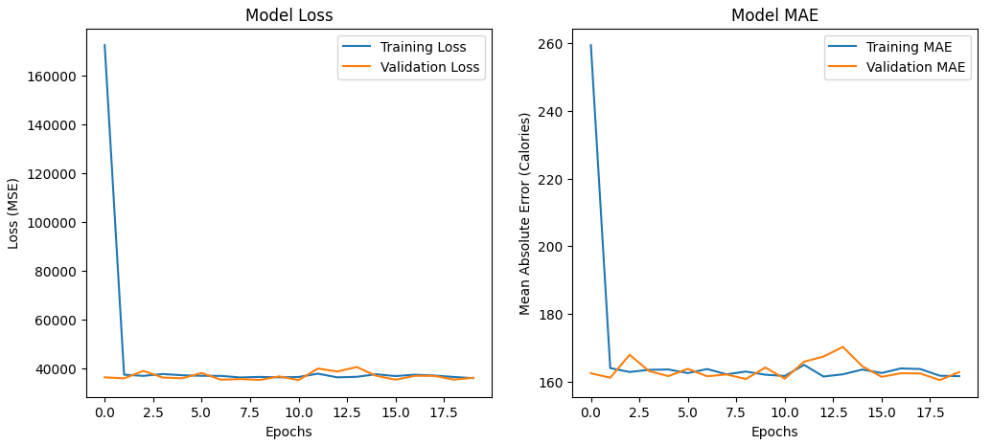
RNN Model for predicting future trends
Model Compilation and Training:
Loss function: MSE
Optimizer: Adam
Evaluation metrics:
Loss (MSE) to track training stability
MAE to track prediction accuracy
Created by : Tyler Keating

Slide 29
Challenges Faced in this Phase and Resolutions
Challenges:
Data Preprocessing Complexity: Ensuring consistency in image formats and handling missing nutritional data.
Model Training Issues: Overfitting in CNN and MLP models due to limited data diversity.
Integration Challenges: Combining CNN, MLP, and RNN models into a unified system.
Computational Constraints: Long training times due to high computational demands.
Resolutions:
Advanced Preprocessing: Applied image augmentation and automated data cleaning scripts.
Hyperparameter Tuning: Adjusted learning rates and regularization techniques to reduce overfitting.
Modular Development: Integrated models step-by-step, ensuring smooth data flow.
Optimized Training: Used Google Colab’s GPU support for faster training.
Created by : Thejaswini Mundargi

Slide 30
Issues to be Resolved for the Final Phase
Model Accuracy Improvement: Fine-tuning CNN for better food classification.
Calorie Prediction Enhancement: Refining MLP model to improve estimation precision.
User Interface Development: Implementing a more interactive and user-friendly prototype.
Real-world Testing: Evaluating model performance on user-submitted images.
Scalability & Deployment: Preparing for cloud-based deployment and API integration.
Created by : Thejaswini Mundargi

Slide 31
Blueprint of next steps for the Final Phase
Model Optimization:
Fine-tune CNN using MobileNetV2 for improved recognition.
Implement feature engineering for better calorie estimation.
System Integration:
Merge CNN, MLP, and RNN models into a single pipeline.
Ensure smooth data flow between components.
User Interface Enhancement:
Develop a functional web app for real-time food recognition.
Integrate API for dynamic calorie retrieval.
Created by : Thejaswini Mundargi

Slide 32
Testing & Validation:
Conduct extensive testing with real-world images.
Improve model robustness through iterative refinement.
Final Report & Presentation:
Document results, methodology, and findings.
Prepare for final project submission and demonstration.
Created by : Thejaswini Mundargi

Slide 33
Phase - llI
Date : 20 April 2025

Slide 34
Final Model Integration Architecture
Key Components :
Input Layer:
User uploads meal image (CNN) or logs meal data (MLP/RNN).
Processing Layer : Model Orchestration:
CNN → Classifies food (Food-101 dataset).
MLP → Estimates calories (USDA data).
RNN → Analyzes meal patterns (historical user data).
API Layer:
REST Endpoints:
/predict_food (POST image → returns food class).
/estimate_calories (POST food + portion → returns calories).
/analyze_habits (POST meal history → returns insights).
Output Layer:
Structured JSON report combining all predictions.
User Interface: Displays results in a dashboard (Streamlit/Flask).
Created by : Thejaswini Mundargi

Slide 35
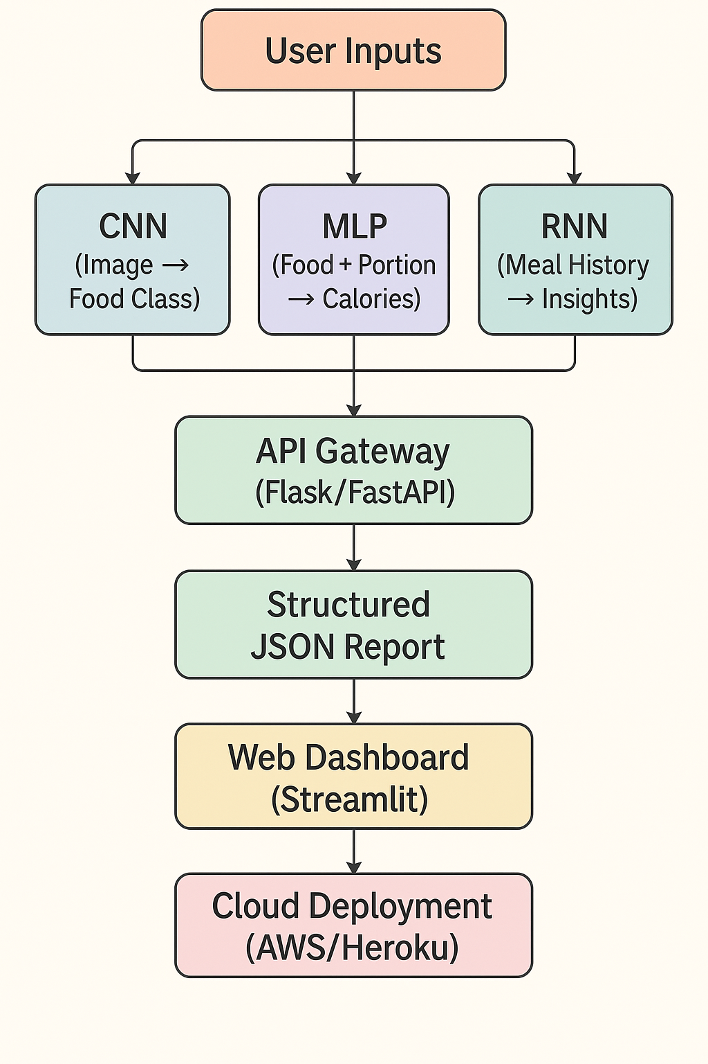
Final Model Integration Architecture
This flowchart visually represents a food analysis pipeline using deep learning and web technologies.
It begins with User Inputs, which are processed by three AI models: a CNN for food classification from images, an MLP for calorie estimation based on food and portion size, and an RNN for generating insights from meal history.
These outputs feed into an API Gateway (using Flask or FastAPI), which compiles the data into a Structured JSON Report.
The report is then visualized on a Web Dashboard (built with Streamlit) and deployed to the cloud via AWS or Heroku.
Created by : Thejaswini Mundargi

Slide 36
Improved CNN Model
Data Augmentation:
Apply strong data augmentation (random resized crop, flips, rotations, color jitter) so the model sees more varied examples and generalizes better to unseen food presentations.
Label Smoothing:
Introduce label smoothing in the cross‑entropy loss to prevent over‑confident predictions and improve calibration.
SDG optimizer
Switch from Adam to SGD with momentum + weight decay for better final generalization on vision tasks.
Learning‑rate schedule
Use a cosine‑annealing LR scheduler to decay the learning rate smoothly rather than hold it constant, helping escape plateaus.
Early stopping
Add early stopping (patience = 7) and best‑checkpoint saving to halt training as soon as validation performance stalls and preserve the best weights.
Created by : Carlos González-Chamorro

Slide 37
Improved CNN Model Architecture
Input
RGB image, resized to 224 × 224 px
Backbone: MobileNetV2 (ImageNet pretrained)
Blocks 0–13: frozen (feature reuse)
Blocks 14–18: unfrozen (fine‑tuned inverted‑residual blocks)
Classifier Head
Dropout layer (p = 0.2)
Fully‑connected layer: 1280 → num_classe
Created by : Carlos González-Chamorro

Slide 38
Improved CNN Model Training
Hardware & Setup
Using device: cuda (NVIDIA RTX 3070 Ti)
Training Dynamics
Epochs to convergence: 25 (stopped early at patience=7)
Total time: 62.3 min
Loss & Validation Accuracy
Epoch 01: train‑loss 3.3477 → val‑acc 53.20%
Epoch 10: train‑loss 1.6878 → val‑acc 72.20%
Epoch 18 (best): train‑loss 1.4631 → val‑acc 73.94%
Epoch 25 (stop): train‑loss 1.3303 → val‑acc 73.43%
Created by : Carlos González-Chamorro

Slide 39
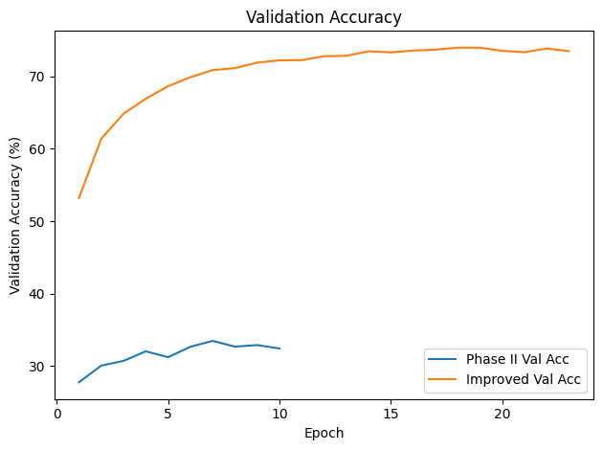
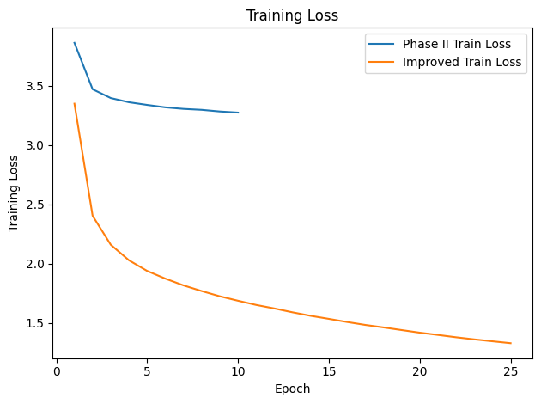
Improved CNN Model Results
Test Accuracy Improvement: From 32.44% to 73.08%
Created by : Carlos González-Chamorro

Slide 40
Optimized MLP Model for Calorie Estimation
Objective: Enhance the performance of the initial MLP model through systematic optimization techniques.
Optimization Strategies Implemented:
Hyperparameter Tuning: Utilized grid search and cross-validation to identify optimal values for learning rate, number of hidden layers, and neurons per layer.​
Regularization Techniques: Applied L2 regularization to prevent overfitting and improve generalization.​
Activation Functions: Experimented with ReLU and tanh activation functions to determine the most effective for our dataset.​
Batch Normalization: Incorporated batch normalization layers to stabilize and accelerate training.
Input Features:
food_label (numerical ending of food item)
portion_size (in grams)
portion_size_square(captures non-linearity)
Model Architecture:
Dense(64, ReLU) → BatchNorm
Dense(32, ReLU) → BatchNorm
Dense(16, ReLU)
Output: Dense(1, Linear)
Optimization Techniques:
Adam optimizer with learning rate 0.001
Earlystopping with patience=15
Trained for up to 150 epochs with batch size 64
Created by : Gayatri Sanjay Gaikwad

Slide 41
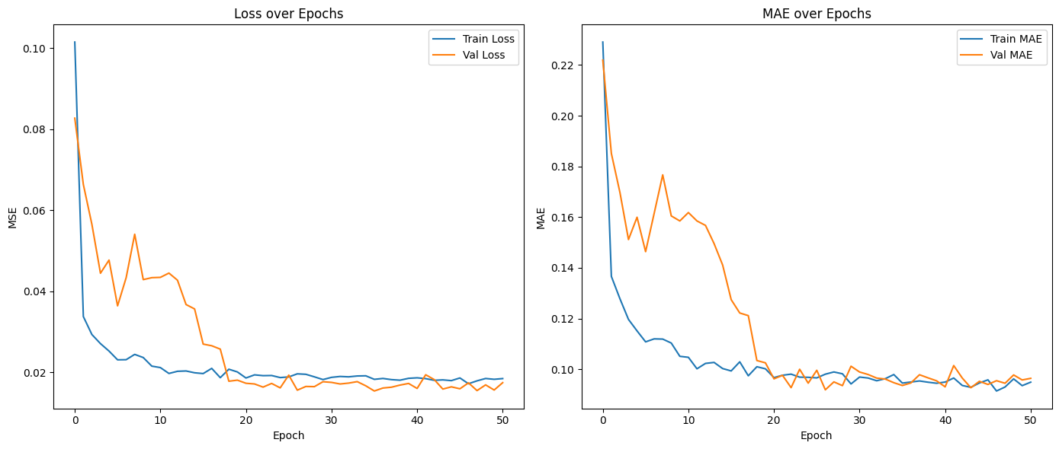
Optimized MLP Model for Calorie Estimation
Results & Metrics (MLP – Final Version)
Key Takeaways:
Model performance improved with new target and features.
MAE ~150 kcal is acceptable for calorie-level estimation from coarse input (only food name + portion).
Model generalizes better with MinMax scaling and non-linear features.
Visuals
Plot 1: MSE loss Plot 2: MAE
Metric | Values
R2 score | ~ >= 0.10(aim to improve over random baseline)
RMSE(kcal) | ~209 kcal
MAE(kcal) | ~154 kcal
Created by : Gayatri Sanjay Gaikwad

Slide 42
Optimized MLP Model for Calorie Estimation
Real-World Challenges:
Limited features: No ingredients/macros available in dataset.
Portion size was randomly generated → introduces variance.
Original MLP with log-calories gave negative R² → shifted to total calorie prediction.
High variation in calories per 100g across food types → hard to generalize.
Mitigation:
Used direct total calorie prediction instead of normalized value.
Added polynomial feature portion_size² to account for food density effects.
Applied normalization (MinMaxScaler) to target for smoother loss optimization.
Example Prediction: Pizza @ 150g
Input: "Pizza", Portion: 150g
Prediction: 169.52 kcal
Matches nutritional expectations for a light slice of pizza
Model successfully understands calorie distribution
1/1 ━━━━━━━━━━━━━━━━━━━━ 0s 220ms/step
🍕 Estimated Calories for 150g of Pizza: 169.52 kcal
Created by : Gayatri Sanjay Gaikwad

Slide 43
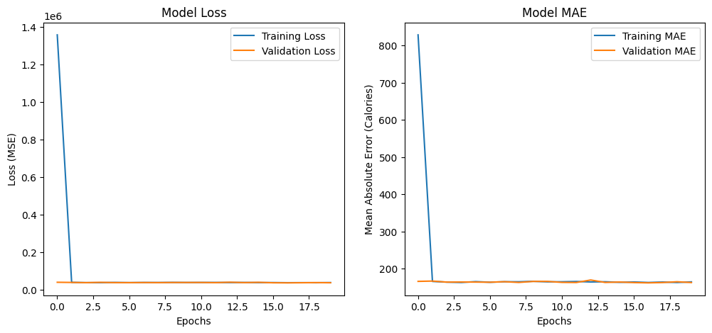
Optimized RNN for future Calorie Estimation
Validation Loss and Error flattened out greatly from the last phase
Still using synthetic data, so no real read on accuracy of the model in relation to the other models
As it stands, the RNN is a fairly simplified concept, as it only reads the number of calories per day
Potential future additions: predicting what food a user would generally gravitate towards on a regular basis, predicting future calories based on different foods a user eats, etc.
Visualizations:
Created by : Tyler Keating

Slide 44
Key Challenges Faced
1. Complex Data Preprocessing
Handling diverse data types—images, numerical nutrition facts, and sequential meal patterns—required a robust and multi-stage preprocessing pipeline. Challenges included:
Ensuring uniformity in image sizes and formats across datasets.
Dealing with missing or inconsistent nutritional information in API data.
Structuring sequential user data effectively for RNN input.
2. Limited Data Diversity Leading to Overfitting
Both the CNN and MLP models initially suffered from overfitting due to:
Lack of diversity in food presentation (lighting, angles, backgrounds).
Randomly generated portion sizes without real-world consistency.
Imbalanced class representation within datasets like Food-101.
Created by : Rudra Hirenkumar Patel

Slide 45
Key Challenges Faced
3. Integration Across Multiple Models
Seamlessly combining the CNN (for classification), MLP (for calorie regression), and RNN (for pattern analysis) into a unified system presented several hurdles:
Ensuring compatibility in data formats between models.
Managing asynchronous outputs (e.g., CNN vs. MLP timing).
Debugging pipeline errors during end-to-end testing.
4. Computational Constraints
Training deep learning models (especially CNNs with image input and RNNs with sequences) was time- and resource-intensive:
Long training durations even with GPU support on Google Colab.
Need to regularly checkpoint and monitor training to avoid wasted compute cycles.
Created by : Rudra Hirenkumar Patel

Slide 46
Key Challenges Faced
5. Calorie Prediction Limitations
The MLP model faced domain-specific issues:
Large calorie variation across food types (e.g., “pizza” can range from 200–500 kcal per 100g).
Lack of ingredient-level details, which limited model precision.
Initial attempts using normalized/log-calorie outputs performed poorly (negative R²), leading to a pivot toward direct calorie prediction.
6. Interface & Usability Challenges (Emerging)
While the backend models progressed, early-stage UI development surfaced issues:
Designing a user-friendly interface for diverse food recognition outputs.
Displaying calorie insights clearly and meaningfully to non-technical users.
Planning for real-world deployment on web or mobile platforms.
Created by : Rudra Hirenkumar Patel

Slide 47
User Interface
Tools Used for UI Design
To design the user interface for the Calorie Snap application, we used the following tools:
Figma: For creating wireframes, designing high-fidelity UI mockups, and ensuring a clean, modern visual aesthetic.
Canva: To enhance visual elements and icons used in presentation materials.
iOS Mockup Preview: Used to simulate a real-device look and demonstrate the app's user flow before implementation.
Created by : Rudra Hirenkumar Patel

Slide 48
User Interface
The Calorie Snap application features an intuitive and minimal design focused on ease of use. On launching the app:
Snap Your Food Section:
Users are prompted to take or upload a photo of their meal through a central widget. The interface provides clear options to either upload an image from the device or capture one using the camera.
Today's Meals Overview:
Displays a placeholder with the message "No meals added yet. Start snapping!" to indicate the user's meal log is currently empty.
Calorie Summary Panel:
A visual summary card shows the total calories consumed today, initially set to 0, with a progress bar leading to the user’s daily calorie goal (default: 2000 kcal).
This clean layout ensures users know exactly what to do next, making the app highly accessible for first-time users and ideal for real-time food logging.
Created by : Rudra Hirenkumar Patel

Slide 49
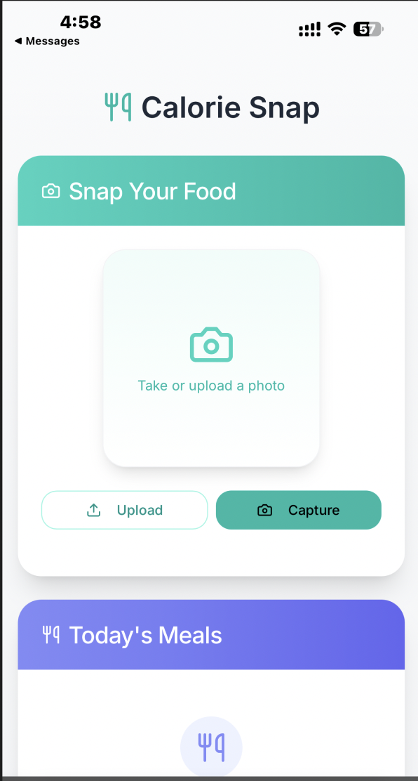
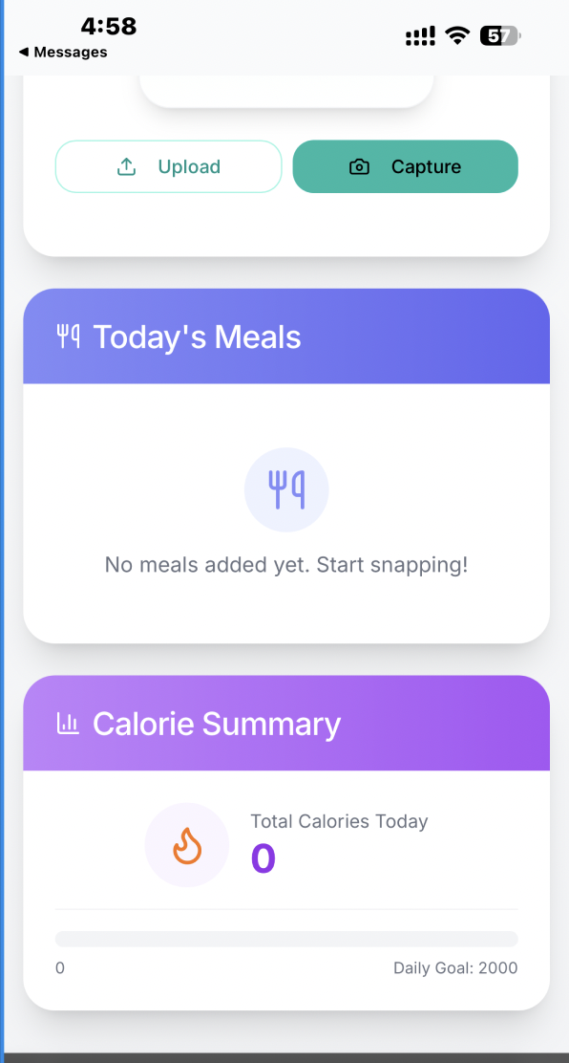
User Interface Prototype(Before Uploading Image)
Created by : Rudra Hirenkumar Patel

Slide 50
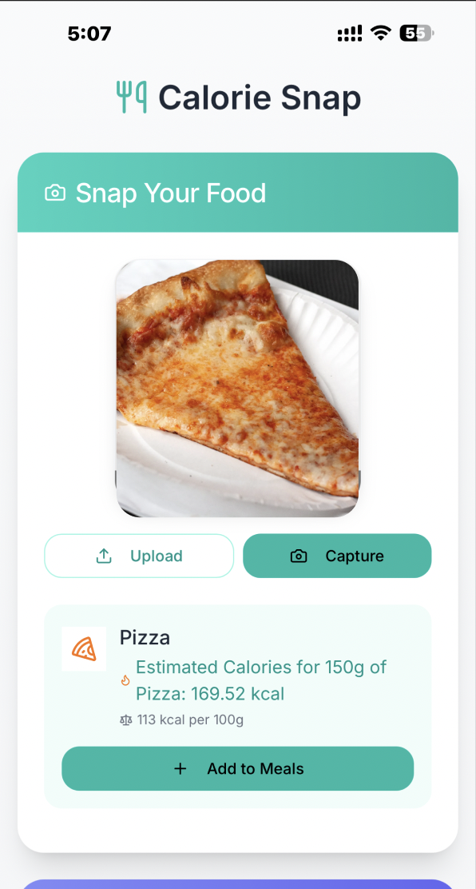
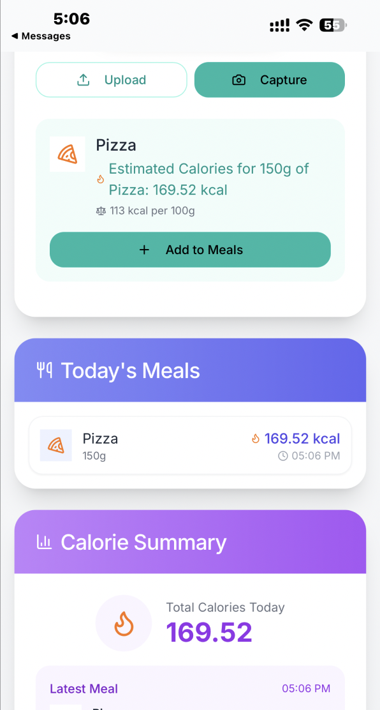
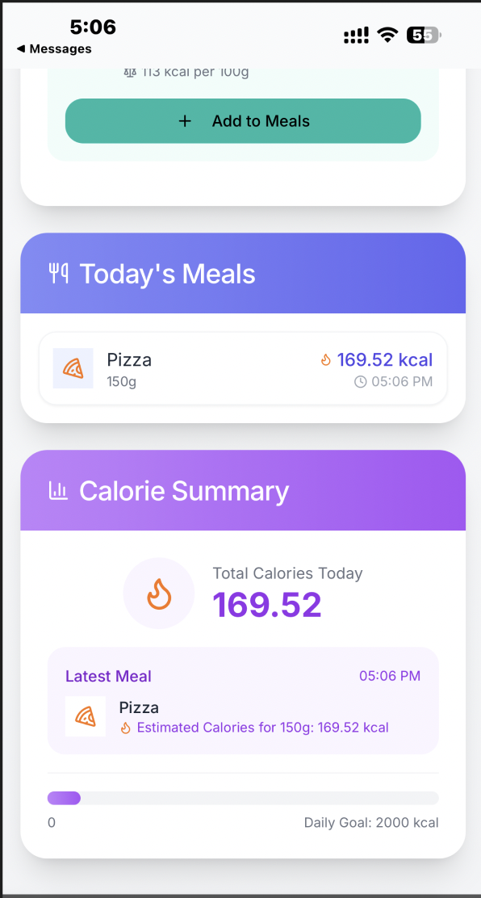
User Interface Prototype (After Uploading Image)
Created by : Rudra Hirenkumar Patel

Slide 51
Deploying the Meal Analysis System (Cloud & API Integration)
Tools used: Flask (Python) or FastAPI.
Key Endpoints:
/predict_food (POST):
Input: Image file.
Output: Food class (e.g., {"class": "pizza"}).
/estimate_calories (POST):
Input: Food class + portion size.
Output: Calorie value (e.g., {"calories": 300}).
/analyze_habits (POST):
Input: User meal history.
Output: Behavioral insights (e.g., {"pattern": "late-night meals"}).
1. Deployment Overview
Save trained models for portability.
Deploy the system on scalable cloud platforms.
Create APIs to connect models to user interfaces.
2. Model Serialization: Saving Models for Deployment
Format: Save models as .h5 (Keras/TensorFlow).
Why .h5?
Lightweight and framework-agnostic.
Compatible with TensorFlow Serving, Flask, and cloud platforms.
3. REST API Design : Building API Endpoints for Model Access
API workflow (User → API → Models → JSON output).
Created by : Thejaswini Mundargi

Slide 52
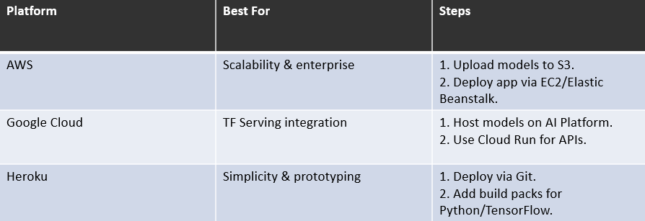
Deploying the Meal Analysis System
4. Cloud Deployment Options: Choosing the Right Cloud Platform for deploying the webapp.
We have chosen Heroku as it has below benefits: Ease of Use, no server setup required, Fast Prototyping. It has Buildpacks for ML and easily installs dependencies via requirements.txt file, deployable via Git and works well with ML models saved as .h5
Created by : Thejaswini Mundargi

Slide 53
Future Work & Possibilities
1. Expanded Datasets - Objective: Broaden the model's understanding and classification accuracy.
Incorporate diverse regional cuisines such as Asian (Indian, Korean, Japanese) and Mediterranean (Greek, Lebanese, Turkish), which are underrepresented in Food-101.
Utilize additional datasets (e.g., UECFood-256, VIREOFood-172) or crowdsource labeled images to ensure accurate representation of complex dishes.
Helps improve food classification and cultural relevance for global users.
2. Real-Time Features - Objective: Enable dynamic, on-the-go tracking.
Introduce live video processing using a mobile or webcam feed to automatically identify and track food intake during meals.
Use frame-by-frame analysis with lightweight CNNs or mobile-optimized models (e.g., MobileNet) to detect food presence, classify items, and estimate portion size in real time.
Could notify users when their portion size exceeds set dietary limits.
Created by : Thejaswini Mundargi

Slide 54
Future Work & Possibilities
3. Personalization - Objective: Tailor insights and recommendations to each user.
Allow users to set personal calorie goals based on factors like age, weight, activity level, and dietary restrictions.
Employ an adaptive RNN or LSTM that learns from each user’s meal history to detect habits, predict cravings, and deliver habit-coaching nudges.Also, suggest healthier alternatives or portion adjustments based on trends.
4. Advanced Models - Objective: Improve accuracy and generalization in predictions.
Replace the traditional MLP (Multi-Layer Perceptron) with Transformer-based models.Transformers can better capture complex relationships between ingredients, portions, and preparation methods.
Supports multi-input learning (text, image, portion metadata), increasing accuracy of calorie estimation.
5. Collaborations - Objective: Foster an ecosystem of holistic health tracking.
Enable integration with popular fitness and health platforms like Fitbit, Apple Health, Google Fit, and MyFitnessPal.
Sync step counts, exercise, sleep data, and combine them with meal tracking to offer comprehensive health analytics. Use APIs to push daily insights, reminders, and diet summaries to external apps.
Created by : Thejaswini Mundargi

